Slide 1
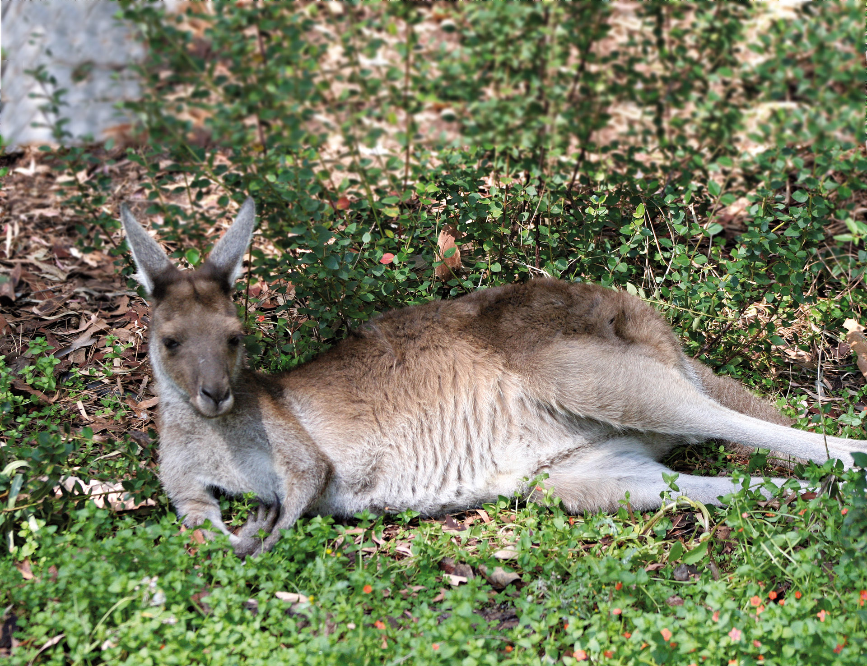
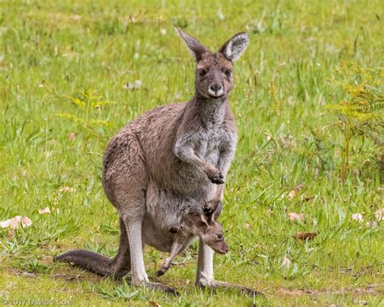
Western Grey Kangaroo
The wild lands of Western Australia are home to an amazing animal called the Western Grey Kangaroo, or in scientific terms, Macropus fuliginosus. This remarkable creature boasts some impressive features that make it uniquely suited to life in Australia's rugged outdoors.
One of the most striking attributes of the Western Grey Kangaroo is its incredible jumping ability. This kangaroo can leap up to 25 feet in a single bound and can reach running speeds of up to 35 miles per hour. That's faster than most people can cycle, making this kangaroo one speedy animal!
The Western Grey Kangaroo is not only fast, but it's also a great protector. The females have a special pouch where the baby, known as a joey, can grow and stay safe from harm. This built-in nursery is one of the unique adaptations of the kangaroo.
Don't be fooled by the kangaroo's gentle nature, though. It has very strong hind legs, which it uses to kick and ward off potential threats. In the wild, these threats can come from dingoes and large birds of prey.
In the grand circle of life, the Western Grey Kangaroo is what we call a consumer. Its diet consists mostly of grass, leaves, and bark. Although it enjoys a largely peaceful existence, it must always stay alert for predators.
The Western Grey Kangaroo is a native species, meaning it's originally from Australia and not introduced from another part of the world. However, it faces some challenges. Farming activities often lead to habitat loss, while road traffic and hunting pose additional threats.
If the Western Grey Kangaroo were to disappear from Western Australia, the impact would be significant. These kangaroos help maintain the health of the grasslands by grazing. Without them, grass could grow too densely, which could increase the risk of bushfires. Also, the predators that rely on kangaroos for food would need to find alternative sources, which could potentially upset the balance of the ecosystem.
The Western Grey Kangaroo, therefore, isn't just an interesting creature. It plays a vital role in the health and balance of its ecosystem, truly making it an important part of our natural world.

Slide 2
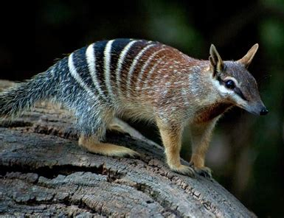
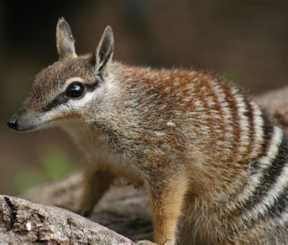
Numbat
Let's journey to the scrublands and woodlands of Western Australia where an interesting creature, the Numbat, or scientifically known as Myrmecobius fasciatus, thrives. This small marsupial, unlike many Australian mammals, enjoys the warmth of daylight hours, making it a diurnal creature, a fascinating uniqueness in its kind. This isn't just a random trait, as the reasons behind it are equally amazing.
The Numbat's daytime activities primarily focus on its dining menu, which includes only one item: termites. To feed on its favourite meal, the Numbat employs its long, slender, and sticky tongue that can stretch out to an impressive 100 millimetres. Believe it or not, this creature can consume up to a staggering 20,000 termites each day! Interestingly, the Numbat has evolved to extract enough moisture from its termite diet that it doesn't need to drink water. These unique traits make the Numbat an essential consumer in the food web of its habitat.
However, life is not all about enjoying termite meals for the Numbat. In the wild, this creature is a potential meal for predators such as foxes, cats, and large birds of prey. Thus, despite its peaceful and somewhat solitary existence, the Numbat needs to remain alert to threats lurking in its environment.
The Numbat is a native species to Australia, which means it was not introduced from other parts of the world. However, as cherished as it may be, it's unfortunately endangered, with the threats to its survival largely stemming from habitat loss and introduced predators. Land clearing for agricultural purposes has significantly reduced the Numbat's natural habitat, while foxes and cats, introduced to Australia by European settlers, pose a significant predatory threat.
The ecosystem is a complex network of interactions, and the removal of one organism, like the Numbat, can have considerable consequences. If the Numbat were to disappear, the termite populations it feeds on could increase dramatically, potentially leading to greater degradation of dead wood and other plant matter. Additionally, the predators who rely on the Numbat as a food source would need to seek alternative prey, potentially putting other species under increased predation pressure.
In summary, the Numbat, with its distinct features and ecological role, is more than just a cute face. It is an integral part of the intricate puzzle of life in Western Australia's woodlands and scrublands.

Slide 3
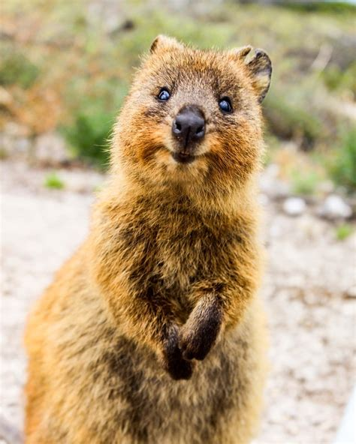
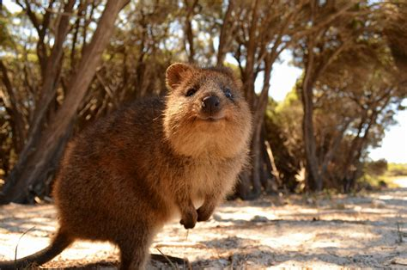
Quokka
Venture into the lush woodlands of Western Australia and you might encounter the ever-smiling face of a Quokka, scientifically known as Setonix brachyurus. With a warm and friendly disposition that has earned it the title of 'the world's happiest animal', the Quokka is a unique marsupial that has captured hearts around the globe.
Despite its fame, the life of a Quokka isn't just about taking cute selfies with tourists. Quokkas are herbivores, which means they primarily feast on plants, leaves, and grasses found in their environment. Their sharp teeth and robust digestive system allow them to extract essential nutrients from a diet that many other creatures would find difficult to digest. These small marsupials thus play a critical role as consumers in their ecosystem's food web, aiding in the control of vegetation.
But as with all creatures, life in the wild presents its challenges. The Quokka must be watchful for birds of prey and introduced predators such as foxes and cats, which pose a significant threat to their survival.
Being a native species to Australia, the Quokka has evolved alongside its local ecosystem. However, it faces several threats that could compromise its future. Among these are habitat destruction, predation by introduced species, and disturbances from excessive human interaction, which sometimes leads to unhealthy feeding and behavioural changes.
If we imagine a scenario where Quokkas were to disappear, it becomes clear that their loss would impact the ecosystem significantly. The plant species they help control by foraging could overgrow, potentially disrupting habitats and the balance of the ecosystem. Furthermore, the predators relying on Quokkas for sustenance would need to seek alternative food sources, possibly putting other species at risk.
In summary, the Quokka, with its distinct features and ecological role, is more than just a cute face. It is an integral part of the intricate puzzle of life in Western Australia's woodlands and scrublands.

Slide 4
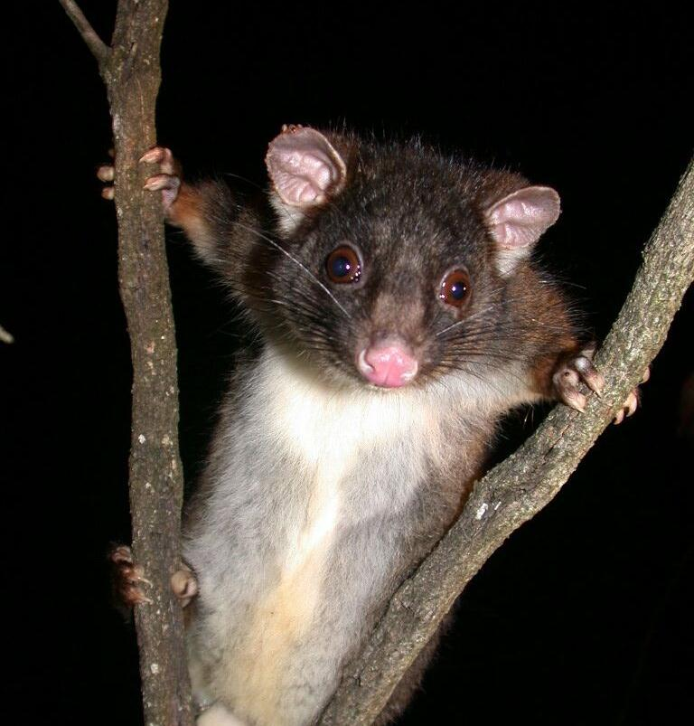
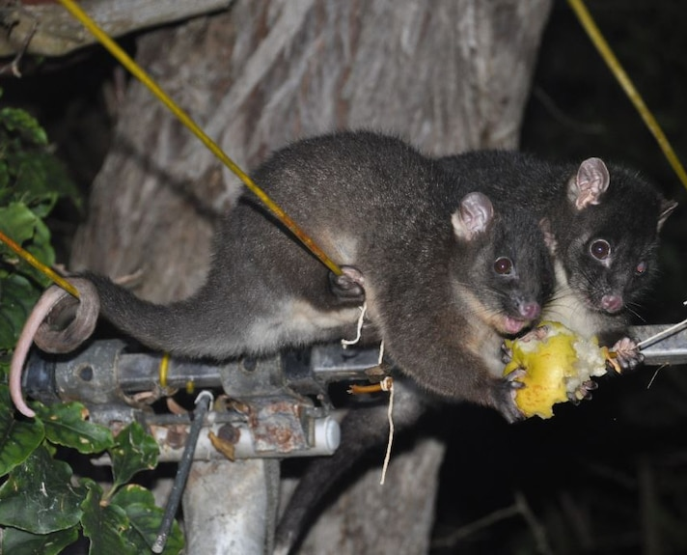
Western Ringtail Possum
Take a midnight saunter through the foliage-rich forests of Western Australia, and you may be graced with a fleeting glimpse of the Western Ringtail Possum, also known by its scientific name Pseudocheirus occidentalis. This nocturnal marsupial is charmingly elusive, possessing a unique grey-brown coat and a prehensile tail used skillfully for grasping branches, making it a noteworthy spectacle in the night.
The Western Ringtail Possum is a vegetarian by nature, feeding predominantly on leaves, flowers, and fruits, especially favoring the Peppermint tree leaves. By consuming these, the possum plays a crucial role as a consumer within its ecosystem. Yet, even though it's primarily an herbivore, this marsupial has a fondness for occasional sweet treats in the form of nectar, displaying its role in pollination.
However, life in the wilderness isn't always tranquil. The Western Ringtail Possum faces threats from natural predators such as large birds of prey, foxes, and cats. As a nocturnal creature, it uses the veil of nightfall to forage, while its ability to glide between trees serves as a defense mechanism against predators.
This enchanting marsupial is native to Australia, particularly prevalent in the southwest region of Western Australia. Yet, the possum's existence is fraught with challenges. Habitat loss due to land clearing for agriculture, housing, and road construction, along with predation by introduced species like foxes and cats, have led to a decline in its population.
Imagine an ecosystem without the Western Ringtail Possum. The absence of this diligent leaf muncher would result in an overgrowth of vegetation, particularly their favored Peppermint trees, causing an imbalance. Simultaneously, the predators relying on the possum for food would struggle to find alternate sources, disrupting the food chain's delicate balance.
In summary, the Western Ringtail Possum's unique attributes and role in controlling vegetation growth highlight its vital place in the Western Australian forests. The possum's survival is not just important for its own species, but also for maintaining the balance of the whole ecosystem. Therefore, conservation efforts aimed at this enigmatic creature are of utmost importance.

Slide 5
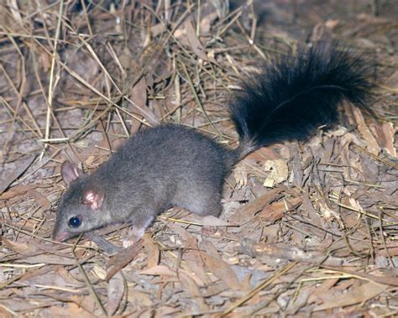
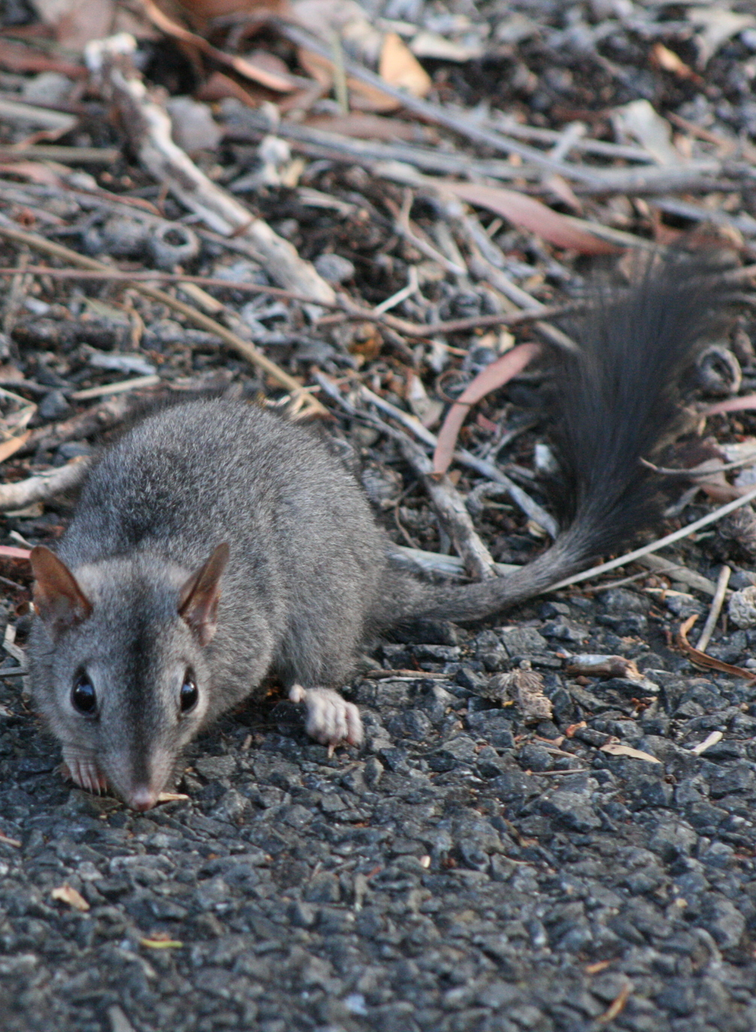
Brush-tailed Phascogale
In the dense woodlands of Western Australia, where the world is filled with the murmur of leaves and the chatter of birds, there resides an intriguing creature, the Brush-tailed Phascogale. This enchanting marsupial, scientifically referred to as Phascogale tapoatafa, is a small yet feisty resident, remarkable for its striking slate-grey coat and bushy tail. This distinct tail is not just a show of beauty but an indication of the creature's readiness to explore the wild, making it one of the unique attributes of this species.
Small as it might be, the Brush-tailed Phascogale is not a creature to underestimate. This tiny hunter comes equipped with sharp teeth and claws, tools it deftly uses to hunt down its meals. It feeds on a surprising variety of creatures such as insects, spiders, and small birds or mammals, showing its adaptability and role as a critical consumer within its ecosystem. But that's not all. The Brush-tailed Phascogale also has a sweet tooth of sorts, as it occasionally feasts on nectar and other plant material, broadening its role in the food web.
Survival in the wild is a test of will and strength, and the Brush-tailed Phascogale knows this all too well. Predators larger and mightier than itself, such as owls, foxes, and cats, pose a significant threat. But this tiny marsupial is not one to bow down easily. The Brush-tailed Phascogale is a creature of the night, using the cover of darkness to not only hunt but also avoid those who wish to make a meal of it.
As a native species of Australia, the Brush-tailed Phascogale has evolved to fit into its local ecosystem, but it does not mean that its survival is guaranteed. It faces challenges that can hamper its future. Land clearing resulting in habitat loss and the introduction of predatory species that were not part of its original ecosystem are significant threats. Furthermore, their unique breeding pattern where males exhaust themselves after an intense mating season, dying off and leaving the females to raise the young, adds another layer of vulnerability.
Now, imagine an ecosystem without the Brush-tailed Phascogale. It's a grim thought, isn't it? If they were to disappear, their prey, especially the insects and small mammals, could rapidly multiply, disrupting the balance of the ecosystem. At the same time, the predators that rely on the Phascogales as a source of food might find themselves in a predicament, having to seek other species for nourishment. This scenario highlights the ripple effect that the loss of a single species can have on the entire ecological system, emphasising the importance of conservation efforts.

Slide 6
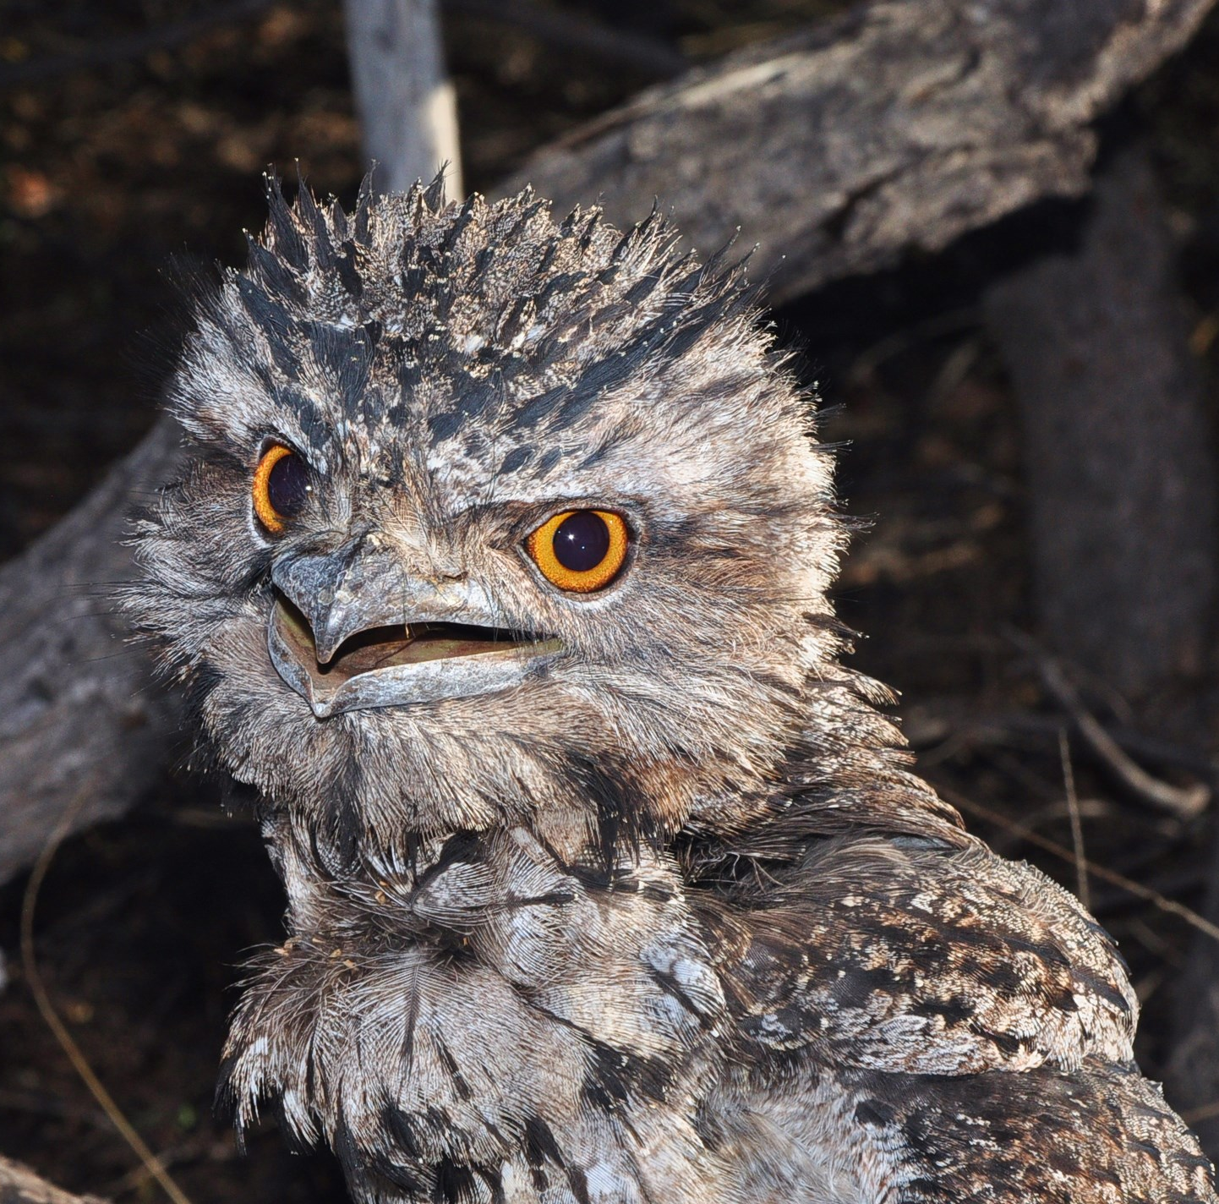
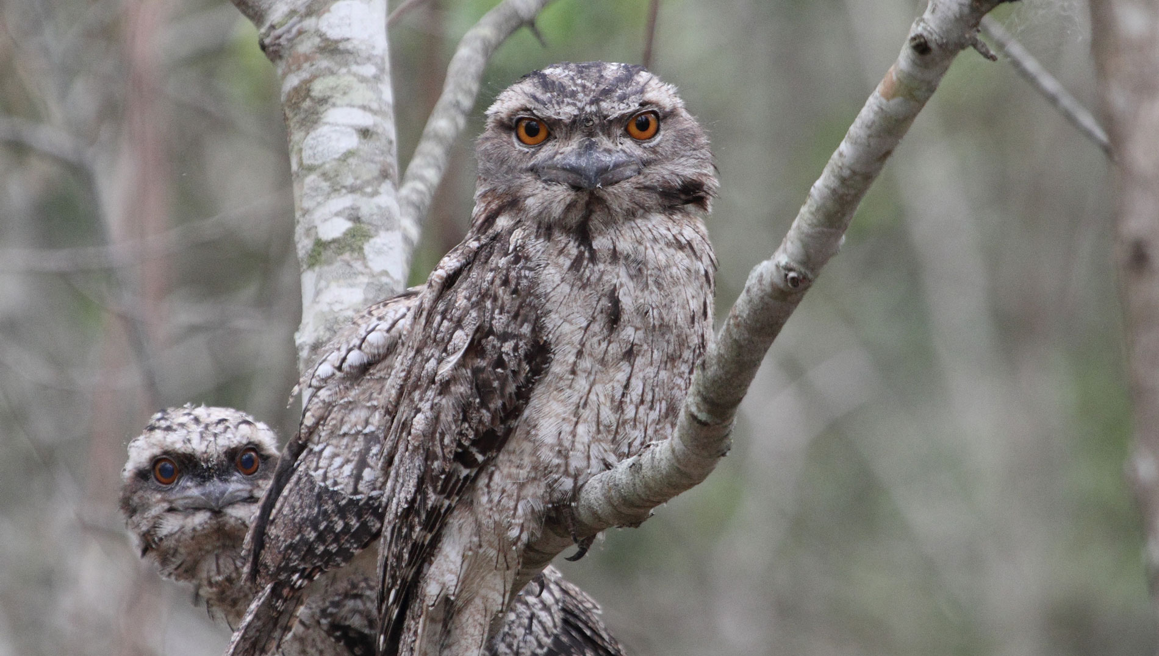
Tawny Frogmouth
As dusk falls in the temperate woodlands of Western Australia, the Tawny Frogmouth, scientifically known as Podargus strigoides, awakens. This fascinating bird, marked by its wide, frog-like mouth and tawny plumage, blends perfectly into the tree branches, making it a master of camouflage.
The Tawny Frogmouth is a consummate predator, albeit not a bird of prey. Equipped with a broad beak and excellent nocturnal vision, it hunts down a diverse diet that includes insects, worms, slugs, and occasionally small mammals and reptiles. By controlling these populations, the Frogmouth establishes itself as a critical consumer within its ecosystem. Interestingly, it also gobbles up leaves and seeds, playing a part in seed dispersal and thus, plant propagation.
Nevertheless, survival in the wild is no easy feat. The Frogmouth has to contend with predators such as owls and eagles, while human-induced threats like road accidents and pesticides also pose significant risks. Its nocturnal lifestyle and incredible camouflage offer some defense, though these alone cannot eliminate all threats.
A native species of Australia, the Tawny Frogmouth faces numerous challenges, with habitat loss due to land clearing and urban expansion among the top. Additionally, as they often nest near roads, vehicle collisions have unfortunately become a common threat.
Now, envisage an ecosystem without the Tawny Frogmouth. An unchecked increase in the populations of insects and other small creatures could lead to an imbalance. Also, the species that rely on the Frogmouth for food may face scarcity, further disrupting the balance of nature.
In conclusion, the Tawny Frogmouth's distinctive attributes and significant role as a predator underline its crucial part in the intricate dynamics of the Western Australian woodlands. The survival of this species is essential not just for its own continuity but also for the overall health of the ecosystem. Hence, efforts to safeguard this remarkable bird are essential in preserving the rich biodiversity of its habitat.

Slide 7
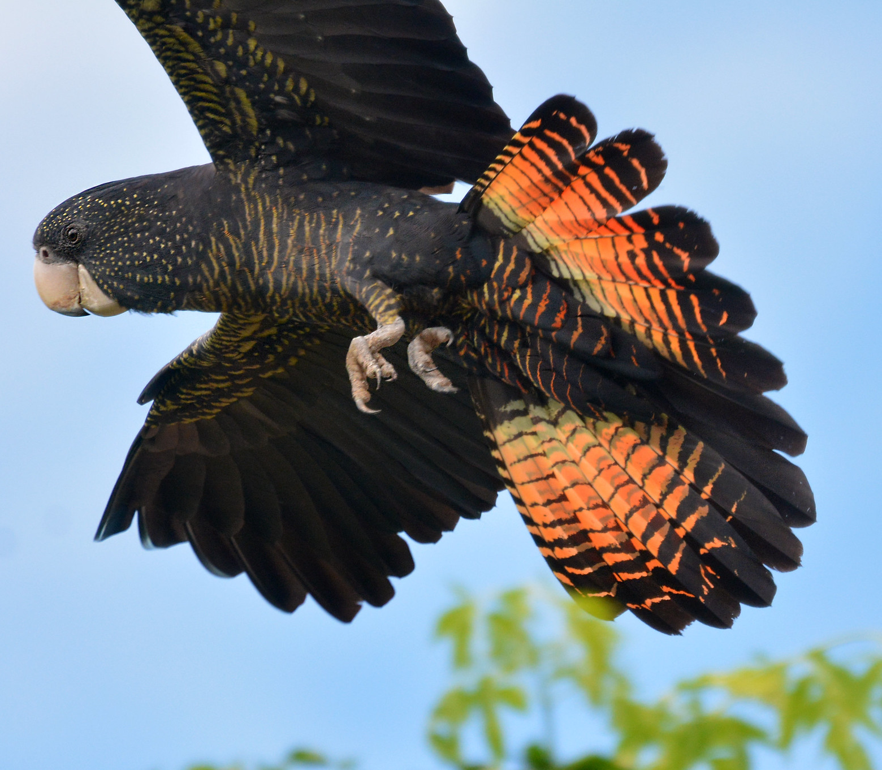
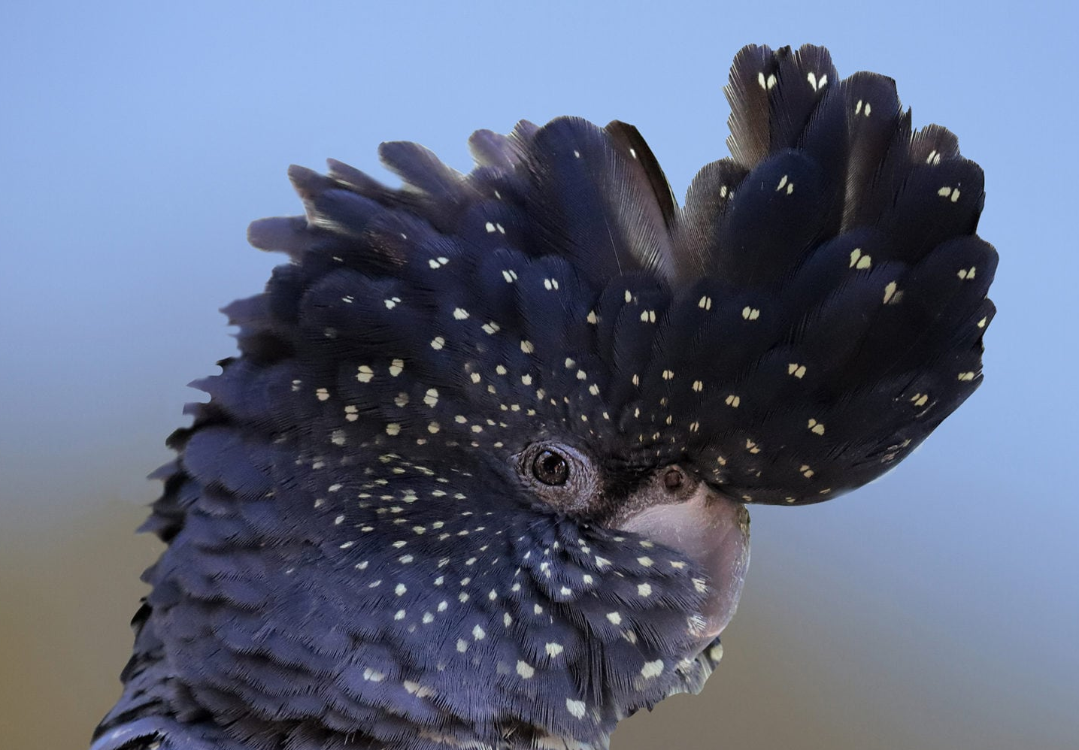
Red-tailed Black Cockatoo
Amid the leafy canopies of Western Australia's woodlands, the Red-tailed Black Cockatoo, scientifically known as Calyptorhynchus banksii, makes its presence known with its striking contrast of jet-black feathers and vivid red tail. This large, charismatic bird is a sight to behold and a sound to be heard, with its raucous call echoing across the forests.
The Red-tailed Black Cockatoo is an adept consumer, feeding primarily on seeds, particularly those of the Marri and Karri trees. It uses its powerful beak to crack open tough seed casings, demonstrating its crucial role in seed dispersal and plant propagation. Occasionally, the Cockatoo supplements its diet with insect larvae, showing its adaptability and wider influence in the food web.
However, life in the wilderness comes with its share of risks. Predators such as large birds of prey and introduced species like foxes and cats pose threats to the cockatoos, especially to their young. As a species that's active during the day, they rely on their keen sense of sight and strong flight to avoid these dangers.
The Red-tailed Black Cockatoo is a native species to Australia. Yet, despite its adaptability, it faces significant challenges to its survival. Deforestation for agricultural expansion and urban development threatens their habitat, while competition for nesting sites from other birds and the illegal pet trade also contribute to their decline.
Imagine an ecosystem without the Red-tailed Black Cockatoo. The trees that depend on the bird for seed dispersal may struggle, affecting plant diversity. Also, species that prey on the cockatoo, such as large birds of prey, might face food scarcity, causing a ripple effect in the ecosystem's balance.
In summary, the Red-tailed Black Cockatoo's prominent role in seed dispersal and its cultural significance to the Aboriginal people underscore its integral position in the Western Australian woodlands. Efforts to conserve this majestic bird are not only essential for its own survival but also vital for the ecological balance of its habitat.

Slide 8
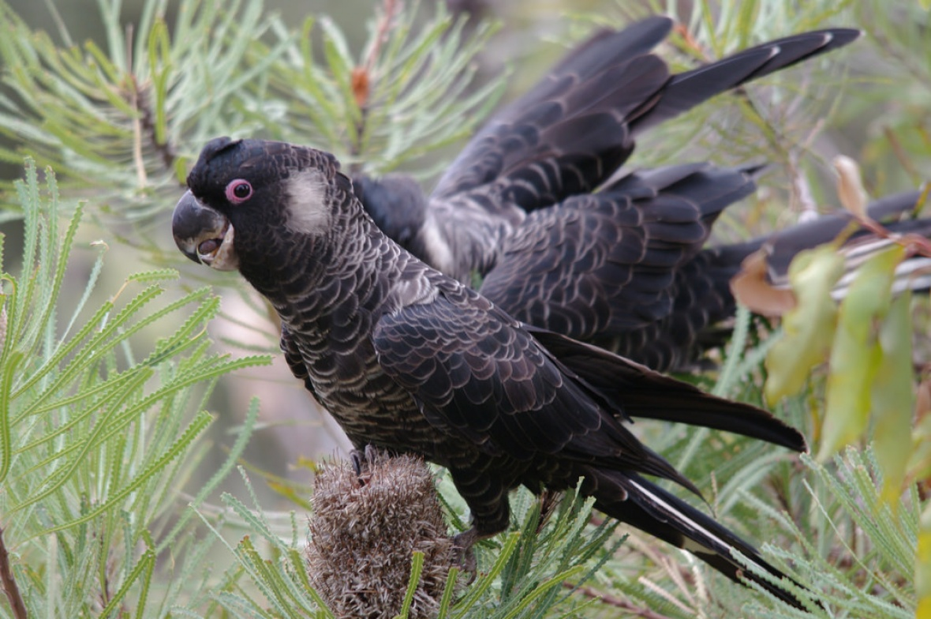
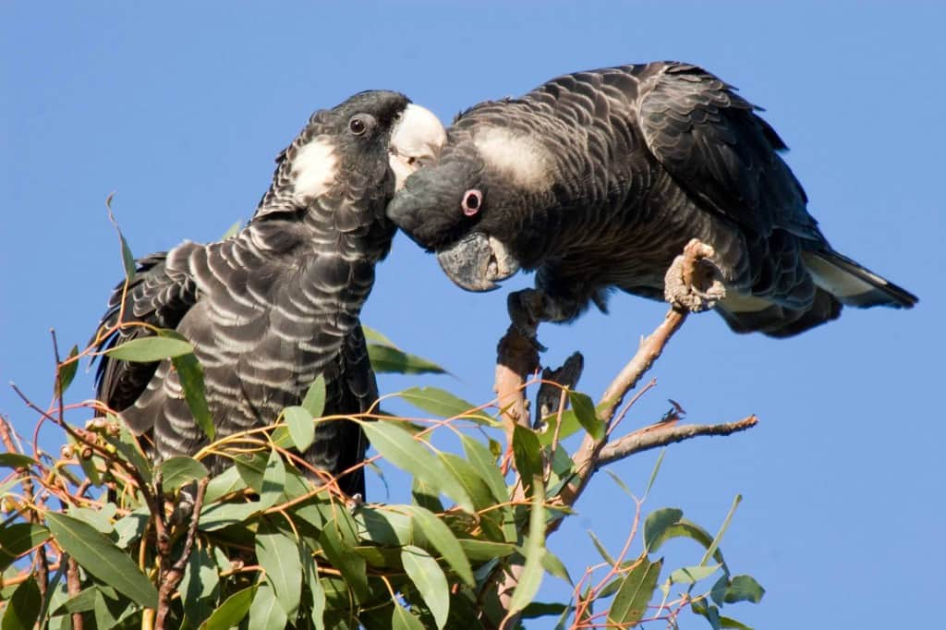
Carnaby's Black-Cockatoo
Among the diverse avian life in the Western Australian skies, the Carnaby's Black-Cockatoo, scientifically referred to as Calyptorhynchus latirostris, is a standout. With its dark plumage and distinctive white tail panels, this bird is an unmistakable sight and sound in the region, recognized by its loud and unique call.
The Carnaby's Black-Cockatoo is a primary consumer in its ecosystem. It feeds mostly on the seeds of native Australian plants, such as the Banksia, Hakea, and Eucalyptus, playing a key role in seed dispersal and contributing to plant diversity. Furthermore, this bird isn't opposed to a little protein and will sometimes indulge in insect larvae, showing its broader role within the food web.
Life in the wild is not without challenges, though. The Carnaby's Black-Cockatoo must be vigilant against predators like large raptors and introduced species such as cats and foxes. With strong wings for speedy escape and a loud call to alert others of danger, they are well-equipped to handle these threats.
Native to Southwest Australia, the Carnaby's Black-Cockatoo faces considerable threats to its existence. Habitat loss due to deforestation and urban development, along with competition for nesting hollows from other species, are among the top challenges. The decline in food availability due to changing land use also puts the survival of this species in jeopardy.
Envisioning an ecosystem without the Carnaby's Black-Cockatoo paints a grim picture. The lack of this significant seed disperser could lead to decreased plant diversity and alterations in the landscape. Moreover, predators that depend on the Cockatoo for sustenance could face food scarcity, disturbing the ecosystem's balance.
In conclusion, the Carnaby's Black-Cockatoo's pivotal role in seed dispersion, coupled with its cultural significance to the Aboriginal people, makes it an essential part of the Western Australian environment. Therefore, the conservation of this bird is not only crucial for the species itself but also fundamental to the health of the ecosystem it inhabits.

Slide 9
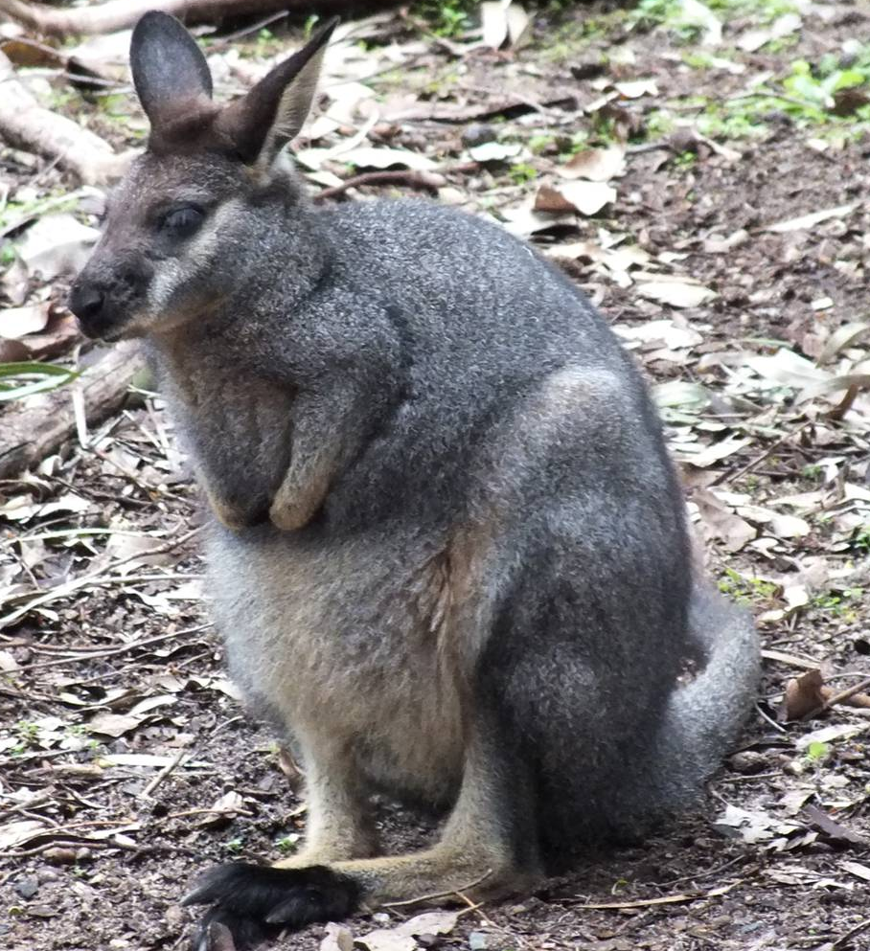
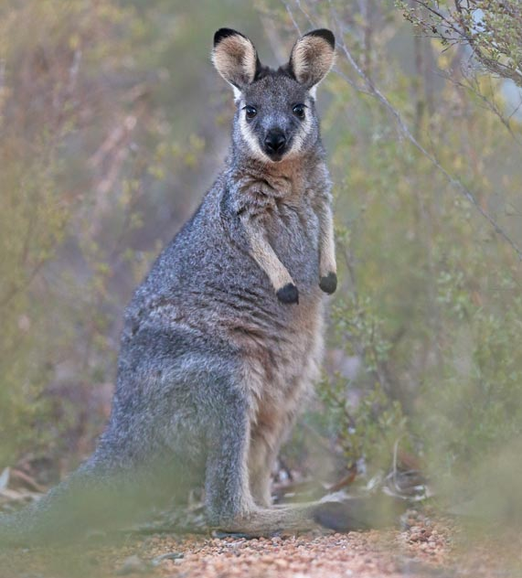
Western Brush Wallaby
In the heart of Western Australia's bushlands, the Western Brush Wallaby, scientifically known as Macropus irma, leaps across the rugged terrain with nimble agility. Sporting a distinct grey-brown coat, this medium-sized marsupial is a captivating sight that personifies the region's rich biodiversity. A local creature that calls Western Australia its home, the Western Brush Wallaby, or the 'black-gloved wallaby' as it's sometimes referred to because of its distinctively darker limbs, effortlessly fits into the tapestry of its natural surroundings.
This remarkable marsupial's diet is largely herbivorous, feeding primarily on grasses and shrubs. This eating habit places it as a consumer within the ecosystem, with its role involving plant control and seed dispersal, indirectly aiding the proliferation of these plant species. Intriguingly, the Western Brush Wallaby also consumes fungi, a trait that isn't common amongst its macropod relatives, indicating a unique role in the local food web that's still not fully understood but certainly contributes to the region's biodiversity.
As agile and swift as the brush wallaby might be, it must remain ever watchful for threats. The dangers it faces are very real, with predators such as dingoes, foxes, and large birds of prey that see it as a source of food. Luckily, its crepuscular nature, being most active during dawn and dusk, provides it with some level of protection, as these are times when many of their predators are less active.
Despite being native to Australia and perfectly adapted to its environment, the Western Brush Wallaby's survival is not without challenges. Its home in the woodland and shrubland habitats of the region faces significant threats from human activities. Habitat loss resulting from deforestation and land clearing for agricultural and urban expansion are considerable threats. Additional pressures such as competition for food and territory with other herbivores, particularly in areas where their habitat is shrinking, can also have an impact on their population.
Contemplating an ecosystem without the Western Brush Wallaby paints an unsettling picture. With its role in vegetation control and seed dispersal taken out of the equation, the unchecked growth of certain plant species could potentially lead to an imbalance. This could drastically alter the terrain and affect other species that have adapted to the current conditions. The predators reliant on the wallaby for sustenance might face a food shortage, causing a ripple effect that could disrupt the broader ecological balance.

Slide 10
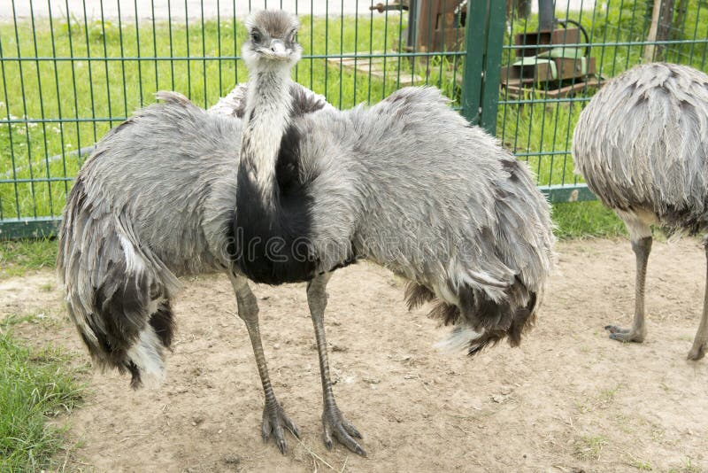
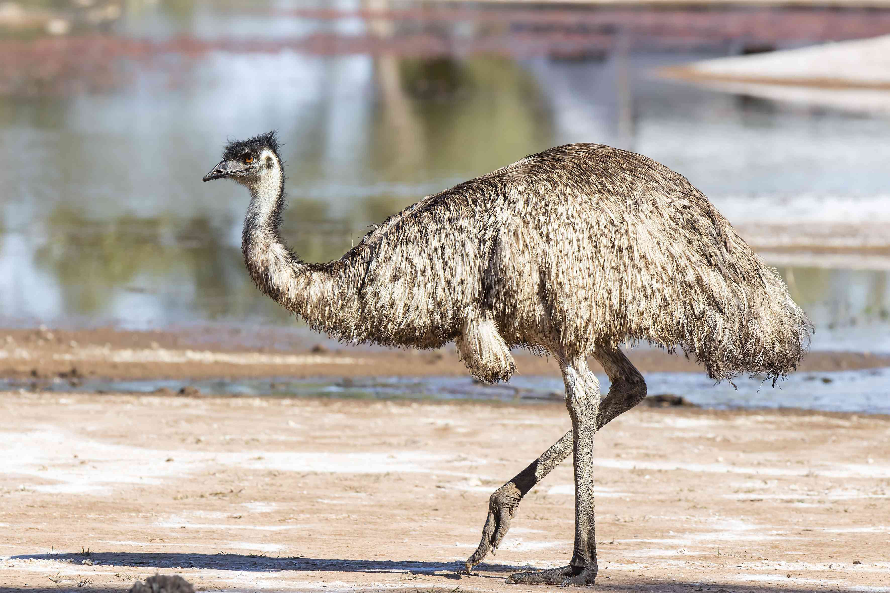
Emu
In the vast expanses of Western Australia, one animal stands tall - literally. The Emu, known scientifically as Dromaius novaehollandiae, is the tallest native bird and the second tallest bird in the world. This flightless wonder, with its long legs, large body, and distinctive blue neck, is a striking feature of the Australian landscape. Its remarkable physical characteristics make it instantly recognizable, and it has earned a place on the Australian coat of arms due to its cultural significance.
The Emu's diet is as diverse as the Australian continent itself. With a preference for plants, seeds, insects, small reptiles, and other tiny creatures, the Emu is a prime example of dietary adaptability. This wide range of sustenance allows it to be a vital component of the ecosystem, playing a pivotal role in seed dispersal. This bird's broad diet emphasizes its complex role within the food web, where it contributes significantly to maintaining biodiversity.
Despite the Emu's intimidating size and impressive running speed - which can reach up to 50km/h - this bird isn't without predators. Young emus are particularly vulnerable to threats from eagles, hawks, and foxes, while adults must be vigilant against dingoes. This intriguing dynamic serves to emphasize the interconnectedness of the ecosystem and the Emu's place within it.
As a species native to Australia, Emus have adapted to a wide range of habitats, from arid areas to coastal regions. However, despite their adaptability, they face significant challenges. Habitat loss due to land clearing for agriculture and urban expansion, collisions with vehicles, and competition for food and resources with livestock are among the main threats. These challenges highlight the pressing need for conservation efforts to ensure the survival of these remarkable birds.
In imagining an Australian ecosystem without Emus, one might perceive a landscape that is not only lacking in one of its most iconic species, but also potentially disrupted in terms of ecological balance. Emus contribute significantly to seed dispersal, and their absence could lead to changes in plant distributions and densities. Moreover, the loss of the Emu could impact the predators that depend on it for sustenance, causing disruptions in the ecosystem's predator-prey dynamics.
In conclusion, the Emu's existence is interwoven with the Australian landscape and ecosystem in many vital ways. Its role in seed dispersal, predator-prey relationships, and its cultural significance make it an essential part of the ecosystem. Protecting the Emu is not just about preserving an iconic Australian species; it also plays a crucial role in maintaining the health and diversity of the ecosystem it inhabits.

Slide 11
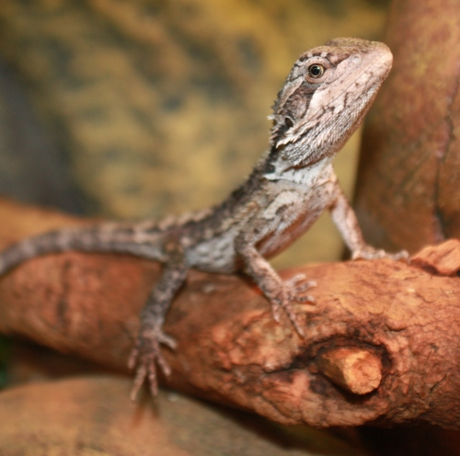
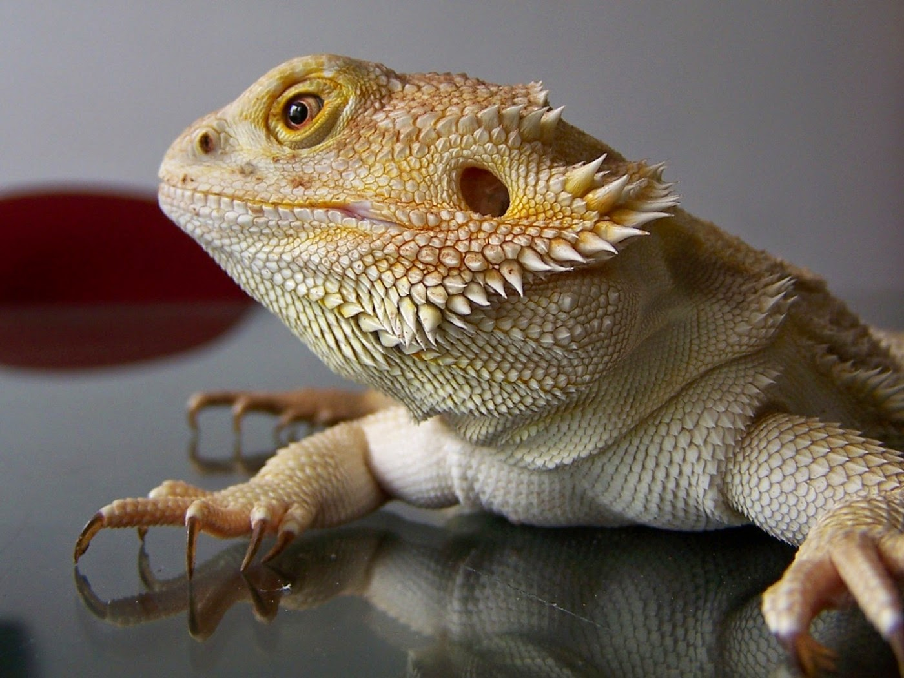
Western Bearded Dragon
Among the rocky outcrops and arid scrublands of Western Australia, the Western Bearded Dragon, Pogona minor, is a prominent figure. Named for the spiny scales around its throat, which give the impression of a beard, this medium-sized lizard is an integral part of the region's diverse reptile population. Its unique physical traits and adaptive behaviours allow it to thrive in its harsh environment.
The Western Bearded Dragon's diet reflects its flexibility and adaptability. It consumes a wide variety of food, including insects, small lizards, and small mammals, which positions it as a predator in the food chain. At the same time, it consumes plant matter such as leaves, fruits, and flowers, suggesting its contribution to seed dispersal and vegetation control. These traits underline its dual role as a predator and an environmental regulator within the ecosystem.
Predators pose a significant threat to the Western Bearded Dragon, despite its cunning survival strategies. Birds of prey, larger reptiles, and feral cats are all threats to this desert dweller. However, the Western Bearded Dragon isn't defenseless. It has evolved the ability to change colour to match its surroundings, a helpful adaptation for avoiding predators. Moreover, when threatened, it puts on a startling display by puffing out its 'beard', which can deter potential predators.
Being a native species to Western Australia, the Western Bearded Dragon has adjusted well to its environment. Nevertheless, it faces a number of challenges, including habitat loss due to agriculture and urban expansion, predation by introduced species, road fatalities, and the impacts of climate change. These concerns underscore the urgency of preserving this species and its habitat for future generations.
If the Western Bearded Dragon were to disappear from its ecosystem, the impact could be significant. Its absence could potentially lead to an increase in the populations of the prey species it usually keeps in check. Simultaneously, predators that rely on the Western Bearded Dragon for sustenance could face a food shortage, leading to a possible disruption of the ecosystem's balance.
In conclusion, the Western Bearded Dragon plays a critical role in the Western Australian ecosystem. Its function as both a predator and a prey, its contribution to plant life through seed dispersal and vegetation control, and its cultural importance to the Aboriginal people of the region make it a vital element in maintaining the ecosystem's biodiversity and balance. The preservation of the Western Bearded Dragon is therefore not only about saving a unique reptile but also about ensuring the stability and diversity of its ecosystem.

Slide 12
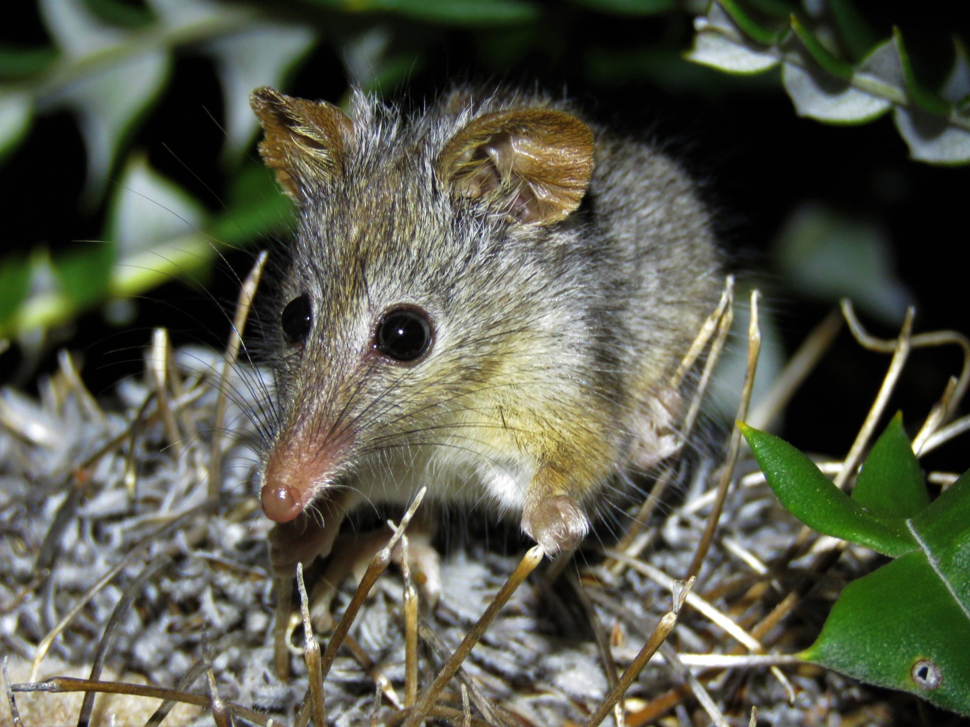
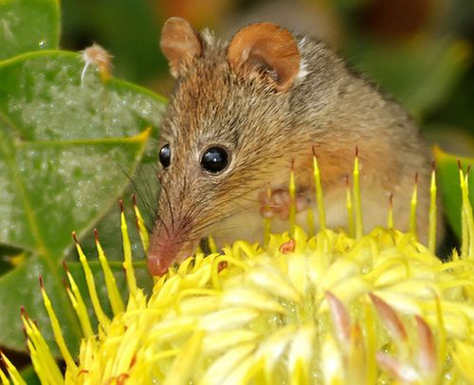
Honey Possum
Deep in the flowering shrubs of Western Australia, there's a creature uniquely adapted to its environment – the Honey Possum, or Tarsipes rostratus. This petite marsupial, small enough to sit comfortably in a human palm, leads a life inextricably linked to the flora around it. Despite its name suggesting a sweet tooth, the Honey Possum is not your average possum – it's the world's only entirely nectarivorous (nectar-eating) mammal, relying on flowers for its sustenance.
Feeding exclusively on nectar and pollen, the Honey Possum has developed an elongated snout and a long, brush-tipped tongue, perfect for reaching into flowers. It plays a critical role in pollination, transferring pollen from flower to flower as it feeds. This characteristic is particularly significant given the tremendous plant biodiversity in Western Australia, making the Honey Possum an indispensable participant in its local ecosystem.
Living a life among the blossoms does not come without risks. The Honey Possum faces threats from a variety of predators, including birds of prey, reptiles, and introduced mammals like cats and foxes. Still, its small size, agility, and nocturnal habits help it avoid these dangers.
As a native species, the Honey Possum is uniquely adapted to the environment of Western Australia. However, it faces significant threats from habitat loss due to land clearing for agriculture, urban development, and climate change impacts. The Honey Possum's survival is directly linked to the flowering plant species it relies on for food, so conservation of these plants is critical for the possum's future.
Imagine an ecosystem without Honey Possums – not only would we lose this unique creature, but the pollination process they aid could be disrupted, possibly leading to reduced plant diversity and abundance. Predators that rely on Honey Possums for food might also face a shortage, potentially disrupting the ecological balance of the region.
To conclude, the Honey Possum is a remarkable creature, a testament to the intricate relationships and adaptations within ecosystems. Its role in pollination, its place in the food chain, and its significance to the Aboriginal people of Western Australia underline its importance within the ecosystem. Efforts to protect and conserve this species and its habitat are crucial for maintaining the balance and diversity of the Western Australian environment.

Slide 13
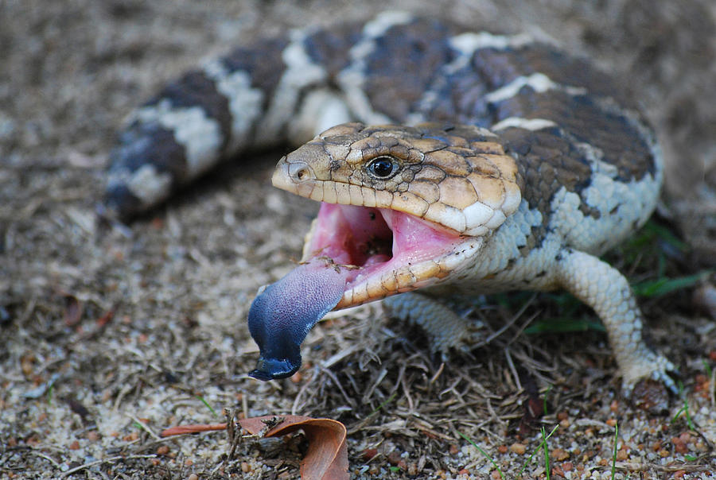
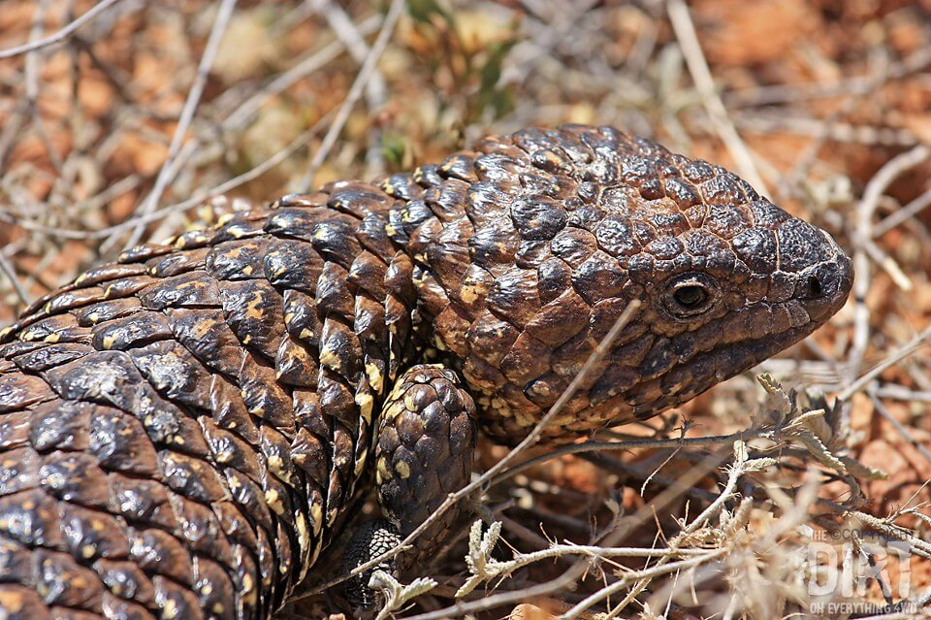
Bobtail Lizard
Basking under the radiant Australian sun, the Bobtail Lizard, or Tiliqua rugosa, is a reptilian emblem of Western Australia. This short-tailed, slow-moving creature is also known as the Shingleback or the Sleepy Lizard due to its laid-back lifestyle. Its robust body, coated with rough, scaly skin and a distinctive, stumpy tail that resembles its head, make the Bobtail Lizard an intriguing character in the Western Australian ecosystem.
In the food web, the Bobtail Lizard is an omnivore, munching on a mix of plant matter and small invertebrates. From berries and leaves to snails and insects, its varied diet helps maintain the balance in its ecosystem. And even though it may not look the part, the Bobtail Lizard plays a crucial role as a predator, keeping the population of invertebrates in check.
But this life isn't without its perils. Birds of prey, large snakes, and introduced mammals like foxes and cats pose a significant threat. Yet, the Bobtail Lizard has a few tricks up its sleeve. Its tough, armoured skin provides some protection, and its tail, resembling a second head, can confuse predators.
As a native species, the Bobtail Lizard is well adapted to the environment of Western Australia. Nevertheless, it faces challenges including habitat loss due to urban expansion and agriculture, road accidents, predation by introduced species, and climate change impacts. These threats emphasise the importance of habitat preservation and conservation efforts to ensure the survival of this unique lizard.
Should the Bobtail Lizard disappear from the Western Australian ecosystem, the consequences could be severe. The balance of the local food web could be disrupted, with an unchecked increase in the population of the small invertebrates it preys on. Furthermore, those predators reliant on the Bobtail Lizard as a food source could suffer from food shortages, affecting their own survival.
In conclusion, the Bobtail Lizard's contribution to its ecosystem extends beyond its distinctive appearance. Its roles as both predator and prey, combined with its importance to the local Aboriginal people as a food source and a feature in Dreamtime stories, make it a vital inhabitant of Western Australia. Conservation efforts to preserve this species are not only about protecting a unique reptile, but they also contribute significantly to maintaining the overall ecological health and diversity of the region.

Slide 14
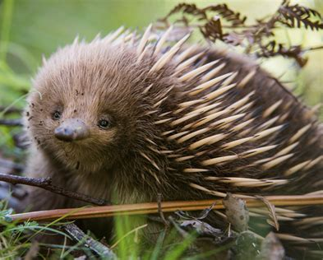
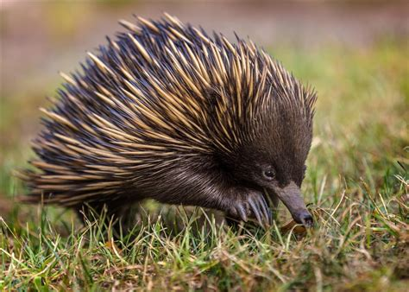
Short-beaked Echidna
Among the vast landscapes of Western Australia, a remarkable creature burrows beneath the surface. It's the Short-Beaked Echidna, or Tachyglossus aculeatus. Not just a typical mammal, the Echidna is a monotreme – a rare kind of mammal that lays eggs. Covered with sharp spines for protection and sporting a slender snout, this unique critter plays an essential role in its environment.
In the food chain, the Echidna is a foraging predator. It uses its long, sticky tongue to slurp up ants, termites, and other small invertebrates. As it munches its way through these tiny creatures, it helps to control their populations, preventing them from becoming too numerous and disrupting the ecosystem. Despite this, the Echidna has its own predators to worry about, including birds of prey and foxes.
Yet, the Echidna isn't defenseless. When faced with a threat, it curls into a tight ball, exposing only its prickly spines to ward off predators. An excellent burrower, it also escapes danger by digging swiftly into the ground.
As a native species, the Echidna is intimately linked to its Western Australian environment. But like other wildlife, it faces challenges, including habitat destruction, road traffic, and climate change. Preservation efforts are crucial to maintaining its presence within the ecosystem.
If the Echidna were to disappear from its environment, the consequences could be substantial. With no natural predator of ants and termites, these tiny creatures could grow uncontrollably in numbers, causing significant harm to the ecosystem. Additionally, those species that feed on the Echidna could face food scarcity.
In conclusion, the Short-Beaked Echidna is much more than a spiky oddity. Its role in the ecosystem as both predator and prey, along with its significance in Aboriginal lore, underline the importance of this unusual mammal. The Echidna's survival is integral to maintaining the balance and biodiversity of the Western Australian ecosystem.

Slide 15
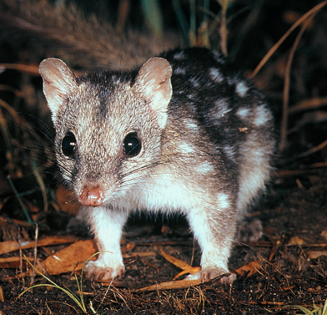
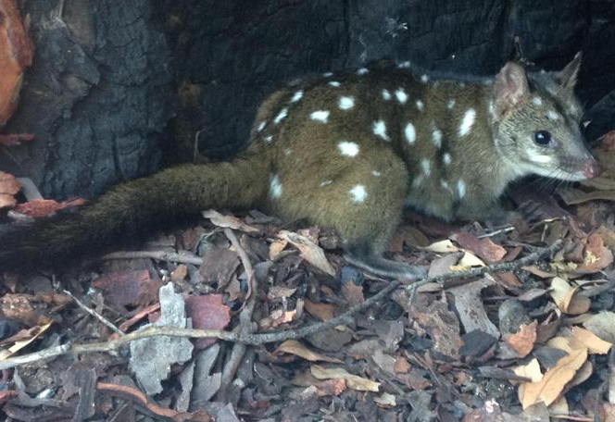
Chuditch
Take a stroll through the sprawling forests of Western Australia, and you may just be lucky enough to spot a Chuditch, or Dasyurus geoffroii. A nocturnal carnivorous marsupial, the Chuditch is fascinatingly enigmatic. It's easily recognized by its distinctive coat, a blend of black, grey, and white with spots adorning its body, making it a standout in the Australian fauna.
Despite being the size of a domestic cat, the Chuditch is an adept predator. Equipped with sharp teeth and claws, it actively hunts a variety of prey, including insects, birds, reptiles, and smaller mammals. As such, it plays an essential role as a top-tier consumer in its ecosystem, helping control the populations of other creatures. Yet, this doesn't mean that the Chuditch limits itself. In addition to its carnivorous diet, it occasionally enjoys feasting on fruits and other plant matter, a testament to its adaptability and broader role in the food web.
Living in the wild isn't a walk in the park, though. The Chuditch must remain ever watchful, for larger predators like owls and foxes pose a significant threat. This is where its nocturnal nature comes into play, offering it some protection by hunting and moving under the cover of darkness.
The Chuditch is an original resident, a native of Australia. However, it faces considerable challenges that put its survival at risk. Habitat loss due to land clearing for agriculture and urban expansion, along with the introduction of predatory species like foxes and cats, are key threats to its existence. Moreover, road accidents have emerged as a modern-day hazard for this beautiful creature.
Contemplate an ecosystem without the Chuditch, and it quickly becomes apparent how crucial its presence is. The sudden absence of this natural predator would allow its prey populations to burgeon, potentially leading to overgrazing and habitat degradation. Simultaneously, the predators who count on the Chuditch for sustenance would face food scarcity, disrupting the delicate balance of the ecosystem.
In conclusion, the Chuditch, through its distinct attributes and crucial role as a predator, paints a vivid picture of the intricate dynamics of life in the Western Australian forests. Its survival and prosperity are vital not only for its species but also for the balanced functioning of its native ecosystem. Hence, efforts to protect and conserve this fascinating marsupial hold the key to preserving the rich biodiversity of its habitat.

Slide 16
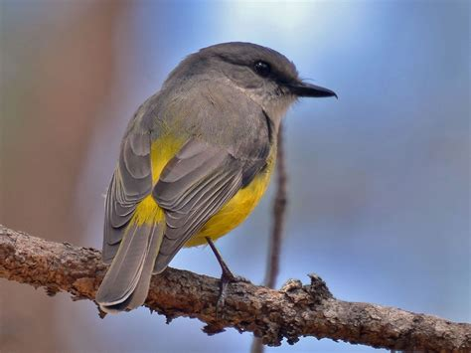
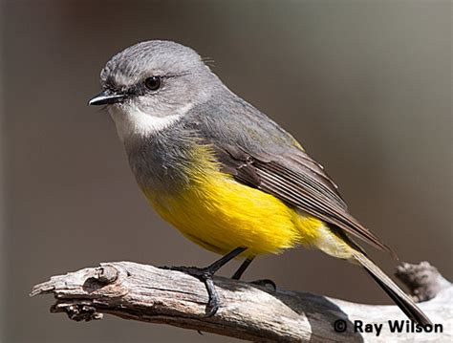
Western Yellow Robin
In the dense forests of Western Australia, a bright flash of yellow flutters between the trees. It's the Western Yellow Robin, or Eopsaltria griseogularis, a small, cheery bird known for its sunny plumage and melodic song. Endemic to this region, it's a critical member of the local ecosystem, making the forested areas its home.
Among the tree branches, the Western Yellow Robin goes about its day, fulfilling its role as an insectivore. It feeds primarily on small insects and spiders, keeping their populations in check. Notably, the robin employs a unique 'wait and pounce' hunting method. It patiently perches, surveying its surroundings before swiftly darting out to snatch an unsuspecting meal. This behaviour is vital in controlling insect populations, ensuring a balanced ecosystem.
However, life isn't all sunshine for this yellow robin. Predators, including larger birds and feral cats, pose significant threats. The robin's bright colouring, although beautiful, makes it an easy target. But being small and agile, the Western Yellow Robin is often able to dodge danger and escape to safety. It uses its quick flight and the dense tree cover to evade these predators.
The Western Yellow Robin, being a native species, is well-suited to the habitats of Western Australia. Yet, it faces substantial challenges that threaten its existence. Habitat loss from land clearing for agriculture and urbanisation, predation from introduced species, and the impacts of climate change put the robin's survival at risk. These threats underline the importance of habitat protection and species conservation for this bird's survival.
If the Western Yellow Robin were to disappear, the effects on the ecosystem could be severe. A potential increase in insect populations could disrupt the balance of the ecosystem. Additionally, predators that rely on this robin for food could face scarcity. This scarcity could then cascade up the food chain, leading to a potential disruption in the ecosystem's balance.
In conclusion, the Western Yellow Robin's role in the ecosystem extends beyond its sunny plumage and delightful song. Its position as a predator and its status as prey highlight its importance within the ecosystem. Beyond that, its melodic song adds to the soundscape of the Western Australian forests, enhancing the overall experience for the human visitors. Efforts to conserve this species and its habitat are crucial for maintaining the biodiversity and balance of Western Australia's environment. This underlines the necessity to maintain sustainable practices and to protect the habitats of our feathery friends.

Slide 17
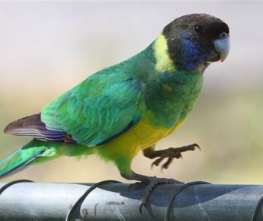
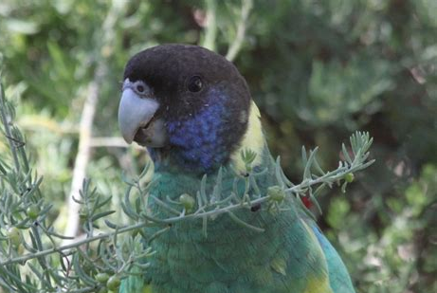
Australian Ringneck
The expansive skies of Western Australia are graced by the vibrant colors and lively chatters of the Australian Ringneck, or Barnardius zonarius. This striking parrot, adorned with shades of green and blue and a distinctive yellow collar, is a native of this region. With its energetic nature and sociable habits, it adds a spark of life to the Western Australian ecosystem.
The Australian Ringneck feeds primarily on seeds, fruits, and insects, making it an omnivore. Its diet helps control the population of certain insects, while its role as a seed disperser promotes the growth of many plants. It forages on the ground, making it vulnerable to predators such as cats, foxes, and birds of prey. Yet, when danger approaches, the Ringneck takes to the skies, its swift flight being its best defense.
Observing the Australian Ringneck in its natural habitat is a delight for nature lovers. Their vibrant colours contrast beautifully with the Australian bush, creating a spectacular sight. Their lively and social behaviour makes them a joy to watch, and their loud, ringing calls add to the unique soundscape of the Australian outdoors.
However, life for the Australian Ringneck isn't always carefree. As a native species, it is adapted to Western Australia's environment, but it faces threats from habitat destruction, competition with introduced species, and illegal capture for the pet trade. These challenges highlight the need for ongoing conservation efforts.
If the Australian Ringneck were to vanish, it could have profound impacts on its ecosystem. A rise in insect populations could occur, potentially leading to an imbalance in the ecosystem. The plants that rely on the Ringneck for seed dispersal could also suffer, affecting the diversity and distribution of vegetation.
The Australian Ringneck is not just a beautiful sight in the sky; its contributions extend beyond its colourful appearance. The bird's roles as both predator and prey, its function as a seed disperser, and its cultural significance to the local Aboriginal people make it a crucial component of the ecosystem. Conservation efforts for this species are not just about protecting a charismatic bird, but they are also integral to maintaining the biodiversity and ecological health of Western Australia.

Slide 18
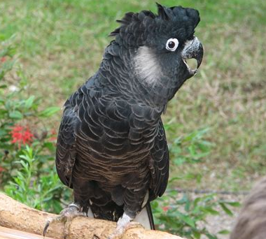
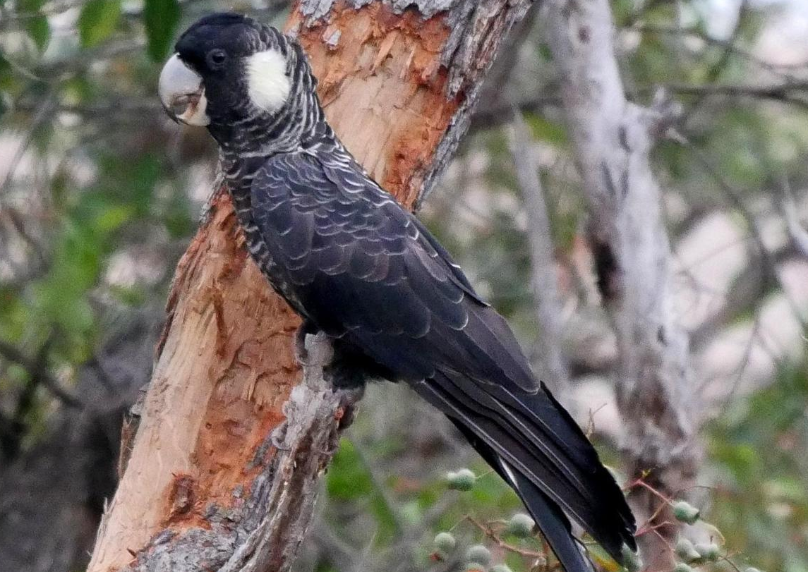
Baudin's Black Cockatoo
Swooping through the forests of Western Australia, a large bird with striking black plumage and a distinctive call can be found. It's the Baudin's Black Cockatoo, or Calyptorhynchus baudinii, a native species that plays an important role in the local ecosystem.
This black cockatoo is a herbivore, feeding primarily on seeds of native trees and shrubs. With its powerful beak, it's one of the few creatures capable of cracking open the large, hard seeds of the Marri tree, making it an essential player in the dispersal of these seeds. The Cockatoo's feeding habits help to promote the growth and propagation of these trees, contributing to the health and diversity of the forest ecosystem.
The sight of the Baudin's Black Cockatoo is quite remarkable. Their dark plumage is a stark contrast to the vibrant green of the forests they inhabit, creating a spectacular sight. The sound of their call echoing through the forest is one of the distinct sounds of Western Australia, creating a unique acoustic environment that is an integral part of the local soundscape.
Despite its size and formidable beak, the Baudin's Black Cockatoo isn't without threats. Predators include large birds of prey, and nestlings are particularly vulnerable to nest raiders like the introduced European fox. Habitat loss due to land clearing for agriculture and urban development, competition with other species for nesting sites, and illegal shooting pose significant challenges to the survival of this cockatoo.
Should the Baudin's Black Cockatoo disappear, the consequences could be severe. The Marri trees, which depend on the cockatoo for seed dispersal, could suffer a decrease in their distribution. Predators of the cockatoo could also experience a decrease in available food sources.
In conclusion, the Baudin's Black Cockatoo is not just an iconic bird of Western Australia; its contributions to the ecosystem are of great significance. Its role as a predator, its function as a seed disperser, and its cultural significance to the local Aboriginal people make it a crucial component of the ecosystem. Conservation efforts for this species are integral to maintaining the biodiversity and ecological health of Western Australia.

Slide 19
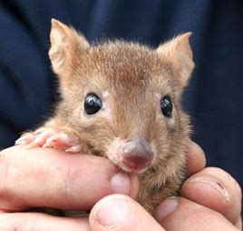
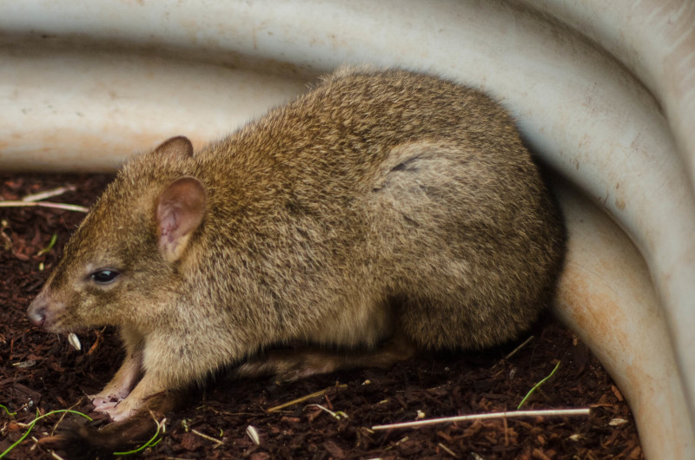
Woylie
In the underbrush of Western Australia's forests, a small creature hops through the darkness. This nocturnal animal, the Woylie or Bettongia penicillata, is an integral part of the local ecosystem. Woylies are native to Australia, and though small, they play a big role in their environment.
Woylies are herbivores and spend their nights foraging for food. They have a varied diet which includes seeds, tubers, bulbs, insects, and fungi. An interesting fact about Woylies is that they are one of the few animals capable of distributing the spores of mycorrhizal fungi, which are beneficial fungi that help plants absorb nutrients from the soil. This trait, in turn, contributes significantly to the health and diversity of the forest.
The busy activities of the Woylie make for an interesting spectacle. They have a peculiar way of moving around, hopping like kangaroos but with a unique gait that is all their own. If you're lucky enough to see one at night, you might catch a glimpse of their long, brush-tipped tail, which they use to carry bundles of nesting material.
Unfortunately, these fascinating creatures are under threat. They are currently classified as critically endangered due to habitat loss, predation from introduced animals such as foxes and cats, and disease. Conservation efforts are underway to protect and increase their populations, but there is still much work to be done.
If the Woylies were to disappear from the Western Australian forests, the impact on the ecosystem would be significant. The loss of an important distributor of mycorrhizal fungi could affect the growth and health of many plant species. Furthermore, the predators that rely on them for food would also suffer, potentially leading to a cascade of effects throughout the ecosystem.
The story of the Woylie is a testament to the importance of every creature in an ecosystem, no matter how small. Its ability to distribute mycorrhizal fungi, its role as a prey species, and its influence on the health of the forest make it a crucial component of Western Australia's ecosystems. Every effort to protect the Woylie and its habitat is a step towards maintaining the rich biodiversity of this part of the world.

Slide 20
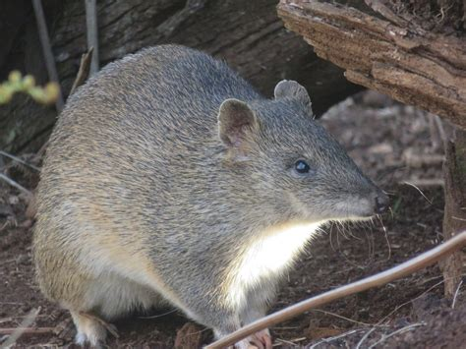
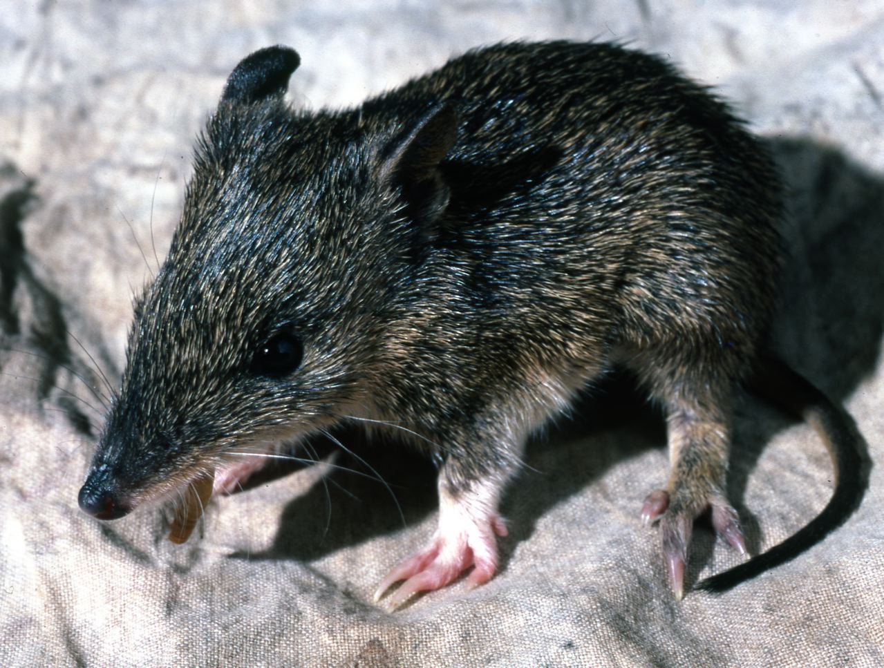
Southern Brown Bandicoot
In the fascinating world of Western Australian wildlife, the Southern Brown Bandicoot or Isoodon obesulus stands as a wonderful example of an ecological engineer. This small marsupial, with its characteristic pointed snout and hump-backed appearance, is native to Australia, contributing greatly to the local ecosystem dynamics.
As an omnivore, the Southern Brown Bandicoot feasts on a smorgasbord of food items, ranging from insects, spiders, and worms to plant roots, tubers, and fungi. This varied diet not only helps to keep certain insect populations in check, but also supports the health and vitality of the local flora. When bandicoots consume fungi and later disperse the spores through their droppings, they play a crucial role in the life cycle of many mycorrhizal fungi species, which assist plants in absorbing nutrients from the soil.
An impressive aspect of the Southern Brown Bandicoot's behaviour is its penchant for digging. Equipped with sharp claws, it digs small holes in search of food, simultaneously aerating the soil and aiding in nutrient distribution. These tiny excavations, though inconspicuous, are essential for the overall health of the ecosystem. They facilitate seed dispersal, provide habitats for insects, and enhance soil fertility, which benefits a wide range of plant and animal species.
However, life is not always easy for these marsupials. They face a variety of challenges that threaten their survival. From habitat loss due to urbanization and agriculture, predation by introduced species like foxes and cats, to competition for resources with other animals – the Southern Brown Bandicoot has to navigate a world full of obstacles. As such, conservation efforts are ongoing to safeguard their population and habitat, but the journey is an uphill one.
Let's imagine a world where the Southern Brown Bandicoot no longer scurries through the undergrowth of Western Australia. Without their digging activity, the soil's health might decline, leading to potential negative impacts on plant growth and soil-dwelling organisms. A rise in certain insect populations could occur without the bandicoot's predatory control. Moreover, those species relying on the bandicoot as a food source might struggle to find adequate sustenance.
The Southern Brown Bandicoot, despite its small size, leaves a significant footprint in its ecosystem. It reminds us that every creature has a role to play, no matter how insignificant it may seem. The bandicoot's roles as predator, prey, and soil cultivator are intertwined in the delicate balance of life in Western Australia's forests. Their story is a poignant reminder of the interconnectedness of all life forms, and the importance of each creature in sustaining the diversity and vibrancy of our natural world.

Slide 21
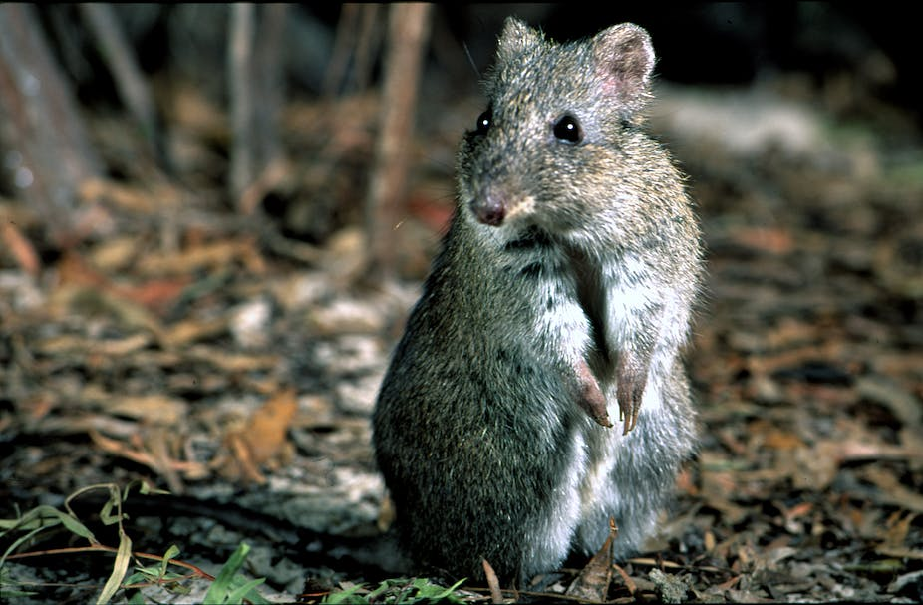
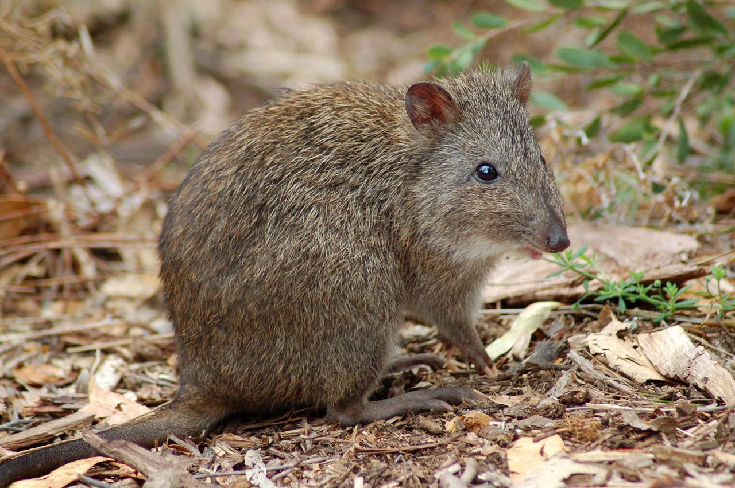
Gilbert's Potoroo
In the dynamic tapestry of Western Australian wildlife, a rarely seen creature holds a significant place – Gilbert's Potoroo, or Potorous gilbertii. This tiny marsupial, also known as the rat-kangaroo, holds the dubious honor of being one of Australia's most endangered mammals. Despite their precarious existence, they play an essential role in their local ecosystem.
Gilbert's Potoroo is a unique animal, as it’s one of the few critically endangered mammals that primarily eat fungi. Their diet consists of underground fungi or truffles, which they locate with their keen sense of smell. After consumption, they spread the spores of these fungi in their droppings, aiding the growth of beneficial fungi that form relationships with plants to help them access nutrients. This makes the potoroo an integral part of nutrient cycling in the forest ecosystem.
An intriguing aspect of Gilbert's Potoroo is their locomotion. Like kangaroos, they hop on their hind legs, but they are also capable of moving on all fours when they're foraging for food. This unique way of moving is a joy to watch if you're lucky enough to spot one of these elusive creatures.
Sadly, Gilbert's Potoroo faces significant threats to its survival. Predation by introduced species such as foxes and cats, along with habitat loss due to land clearance for agriculture and urbanization, have led to a sharp decline in their numbers. They are also affected by diseases such as the Phytophthora fungus, which damages the vegetation they rely on.
Imagine if Gilbert's Potoroo were to disappear from Western Australia's forests. The dispersal and growth of beneficial fungi could be significantly impacted, leading to potential negative effects on the health and diversity of the forest ecosystem. Predators that depend on the potoroo for food could also face a decrease in their food supply, potentially disrupting the local food chain.
Despite their small size and elusive nature, Gilbert's Potoroo plays a substantial role in the Western Australian ecosystem. Their unique feeding habits contribute to nutrient cycling, their existence provides food for certain predators, and their struggle for survival is a reminder of the fragile balance that exists within nature. The conservation of Gilbert's Potoroo is not just about saving a single species, but about preserving the rich and diverse ecosystem they are a part of. Their story underscores the importance of every creature in the ecosystem, no matter how small or seemingly insignificant.

Slide 22
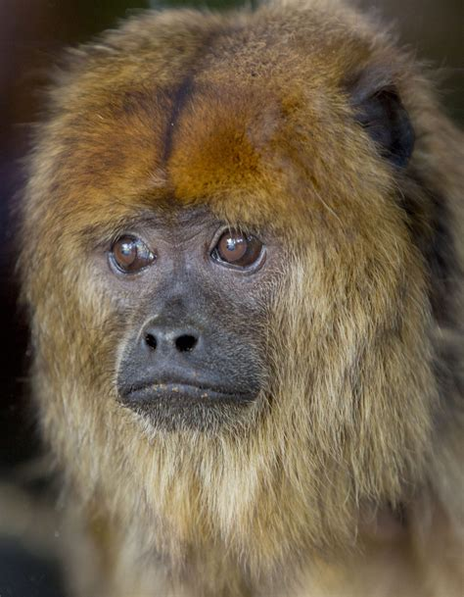
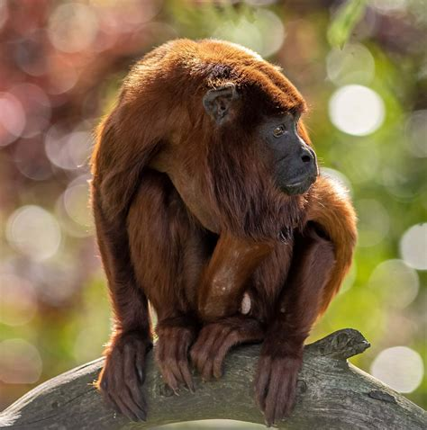
Howler Monkey
In the lush, vibrant rainforests of Central and South America, a distinctive sound echoes through the tree canopy – the call of the Howler Monkey, scientifically known as Alouatta. Recognized as the loudest animal in the New World, these monkeys have a roar that can be heard up to 3 miles away. But their contribution to the ecosystem is much more than their powerful voice.
The Howler Monkey is primarily a herbivore, feasting on a variety of leaves, fruits, and flowers. They have a specially adapted digestive system that allows them to break down leaves that other monkeys cannot, a process that involves unique gut bacteria. This specialized diet makes them crucial seed dispersers in their environment. As they roam from tree to tree, they scatter seeds through their droppings, encouraging the growth and proliferation of many plant species throughout the forest.
Howler Monkeys are famous for their locomotion method – they use their prehensile tails, which function as a fifth limb, to swing and hang from tree branches. This adaptation allows them to navigate the forest canopy with ease and find food sources that might be out of reach for other creatures.
Despite their adaptability and strength, Howler Monkeys face numerous threats. They are often affected by habitat loss due to deforestation and land conversion for agriculture. In some regions, they are also hunted for food and captured for the pet trade. All these factors put a strain on their populations and their overall health.
Let's consider a rainforest without the distinctive call of the Howler Monkey. Not only would the forest lose one of its loudest voices, but the absence of these monkeys could also potentially affect the distribution and survival of certain plant species that rely on them for seed dispersal. Predators such as large cats, birds of prey, and snakes would lose a significant source of food, potentially disrupting the delicate balance of the food web.
In conclusion, the Howler Monkey is a central figure in its ecosystem, despite the challenges it faces. Its unique feeding habits contribute to the rich diversity of plant life, while its existence provides food for various predators. Their conservation is not just about preserving a species, but also about maintaining the complex network of life that flourishes within the rainforest. The echo of their calls serves as a reminder of the interconnectedness of all life forms and the need to protect the world's diverse ecosystems for future generations.

